Slide 1
Portal das Finanças
IHC - Assignment 1
2021/2022
André Clérigo, 98485
Cláudio Asensio, 98433
Pedro Rocha, 98256

Slide 2
01 Introduction
05 Appreciation
03
Results & solutions
02
Heuristic
Evaluation
06 Honourable
mentions
04 cOGNITIVE
WALKTHROUGH

Slide 3
01. Introduction

Slide 4
Motivation
Our personal experience with the service
Teacher’s feedback about the platform
While exploring we found clear issues with the system’s UI/UX
Note: The website we are going to evaluate is the 2022 version.

Slide 5
Portal das Finanças
What is Portal das Finanças:
Portal das Finanças is the official Portugueses Government Tax regulator website. Taxpayers can access the service to verify their tax status and perform various operations related to contributions and statistical information.
Target Users:
The platform is aimed for all Portuguese taxpayers, this is, all people who have income from dependent work

Slide 6
Evaluation
To evaluate Portal das Finanças we are using Jakob Nielsen's general principles for interaction design.
Visibility of system status
Match between system and the real world
User control and freedom
Consistency and standards
Recognition rather than recall
Error prevention
Severity Scale
0 | Disagreeing on the existence of a problem
1 | Cosmetic problem only, to be fixed if there is extra time
2 | Minor usability problem, low priority
3 | Major usability problem, high priority
4 | Usability catastrophe: imperative fix before releasing to production

Slide 7
02.
Heuristic
Evaluation

Slide 8
Heuristic Evaluation
Issue: Login session
Heuristic: Visibility of system status
Severity: 3
Description: There are some specific actions in the system that seem to make the user log off.
Notes:
Exemplo: carregar no botão de homepage faz parecer que estamos logged off

Slide 9
Heuristic Evaluation
Issue: Navigation to the homepage
Heuristic: Match between system and the real world & Consistency and standards
Severity: 3
Description: The button that appears to be the Homepage redirects the user to another website.
Notes:
O botão redireciona para um outro website; o botão Logo para a homepage nem sempre está visível; o standard é o botao de homepage (se nao for o logo) estar na primeira posição do menu;

Slide 10
Heuristic Evaluation
Issue: Constantly changing menu
Heuristic: Recognition rather than recall
Severity: 4
Description: Rather than expanding the starting menu, when a user chooses a section the old menu is replaced

Slide 11
Heuristic Evaluation
Issue: Message deletion without confirmation
Heuristic: User control and freedom & Error prevention
Severity: 2
Description: In the messages section the user can accidentally delete a message and never recover it back

Slide 12
03.
Results & Solutions

Slide 13
Results & Solutions
André
Cláudio
Pedro
Median
Login session
3
2
3
3
Navigation to the homepage
4
3
3
3
Constantly changing menu
4
4
4
4
Message deletion without
confirmation
2
3
2
2

Slide 14
04.
Cognitive
Walkthrough

Slide 15
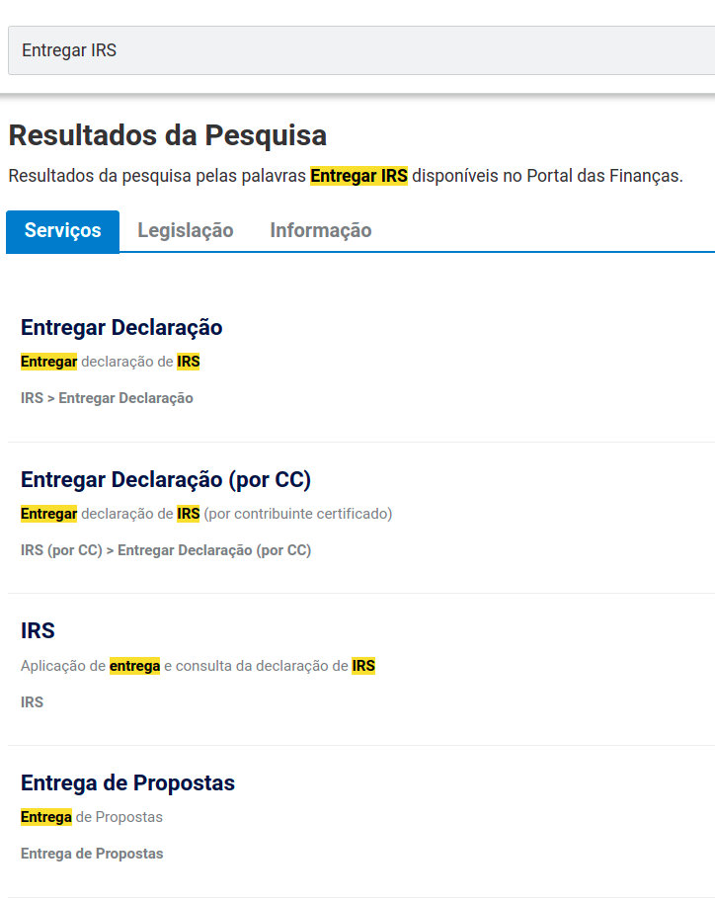
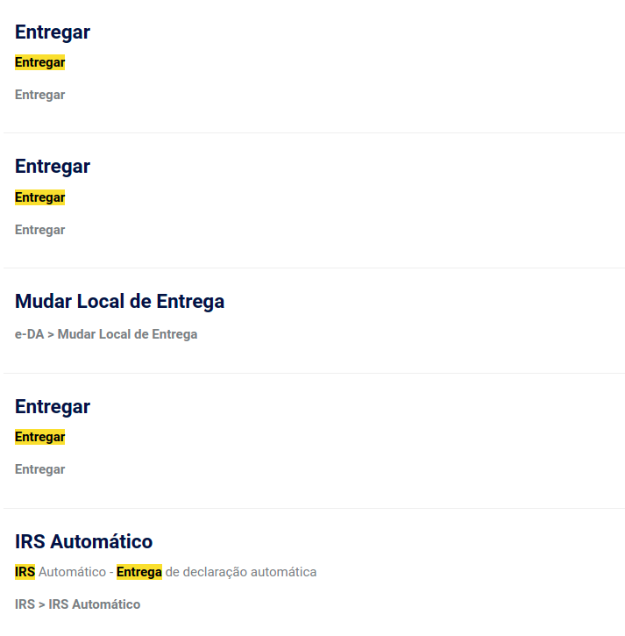
Cognitive Walkthrough
01. Task 1
02. User
03. Issue
04.Question
Search for deliver IRS action.
A regular Portuguese Taxpayer.
While searching for the correct option the user is presented with similar options.
Does the user know that he chose the correct option?

Slide 16
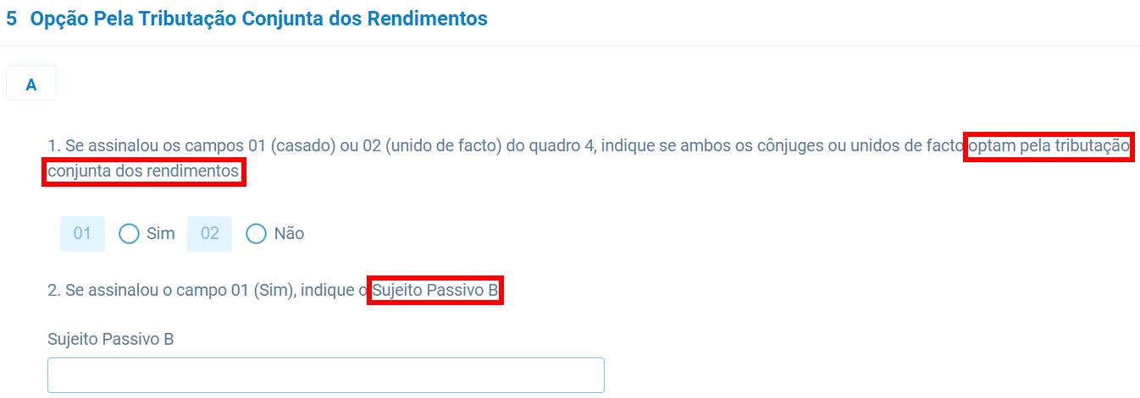
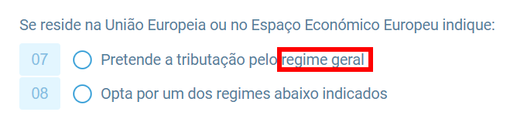
Cognitive Walkthrough
01. Task 2 - Step 1
02. Task 2 - STEP 2
03. User
04. Issue
05. Question
Search for deliver IRS action.
Choose the correct option.
Start filling the IRS report.
A regular Portuguese Taxpayer.
While filling the report the user finds technical terms that may not be clear him.
Does the user know if the fields were filed correctly?

Slide 17
05.
Honorable Mentions

Slide 18
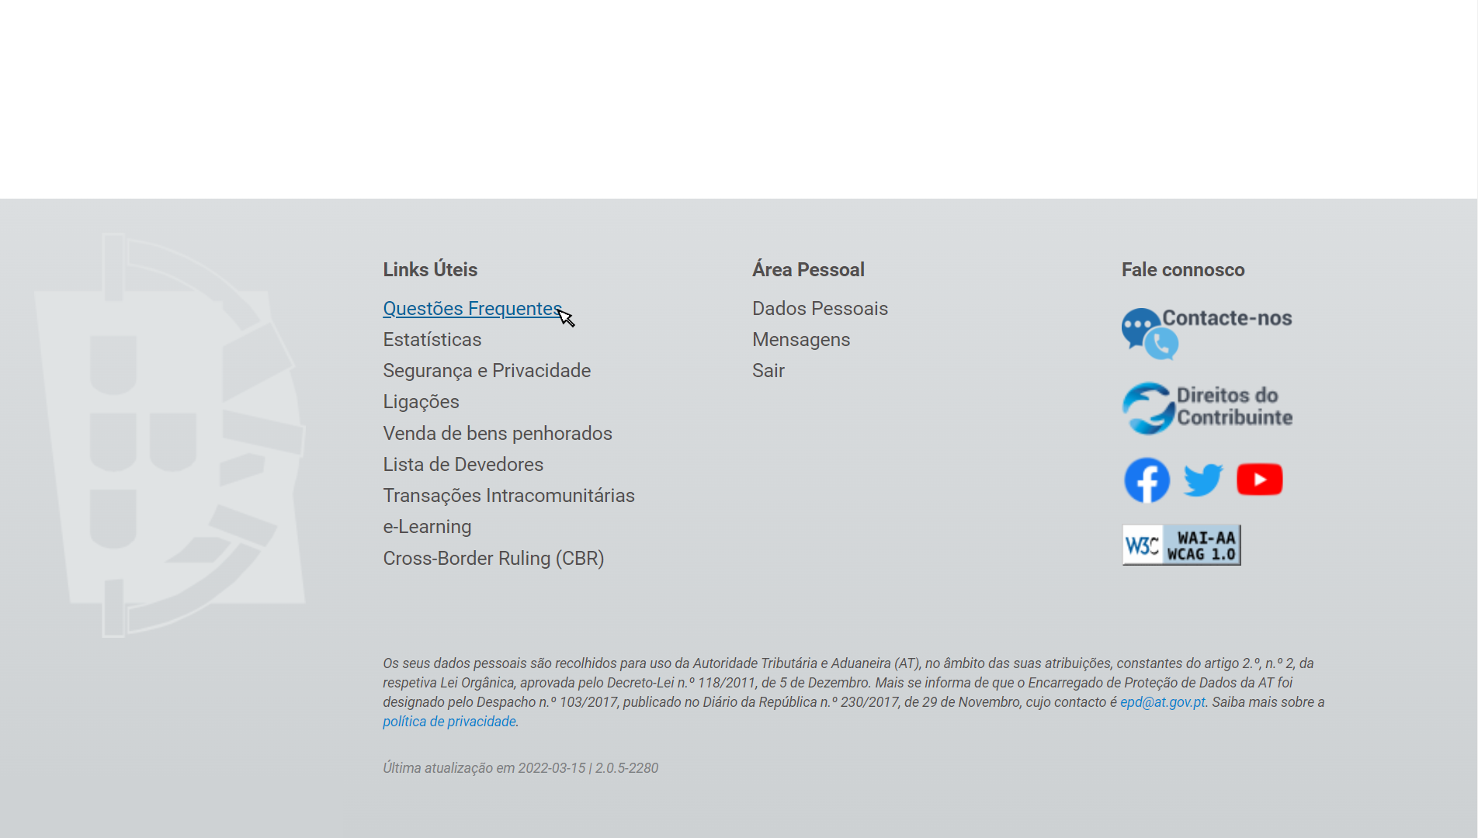
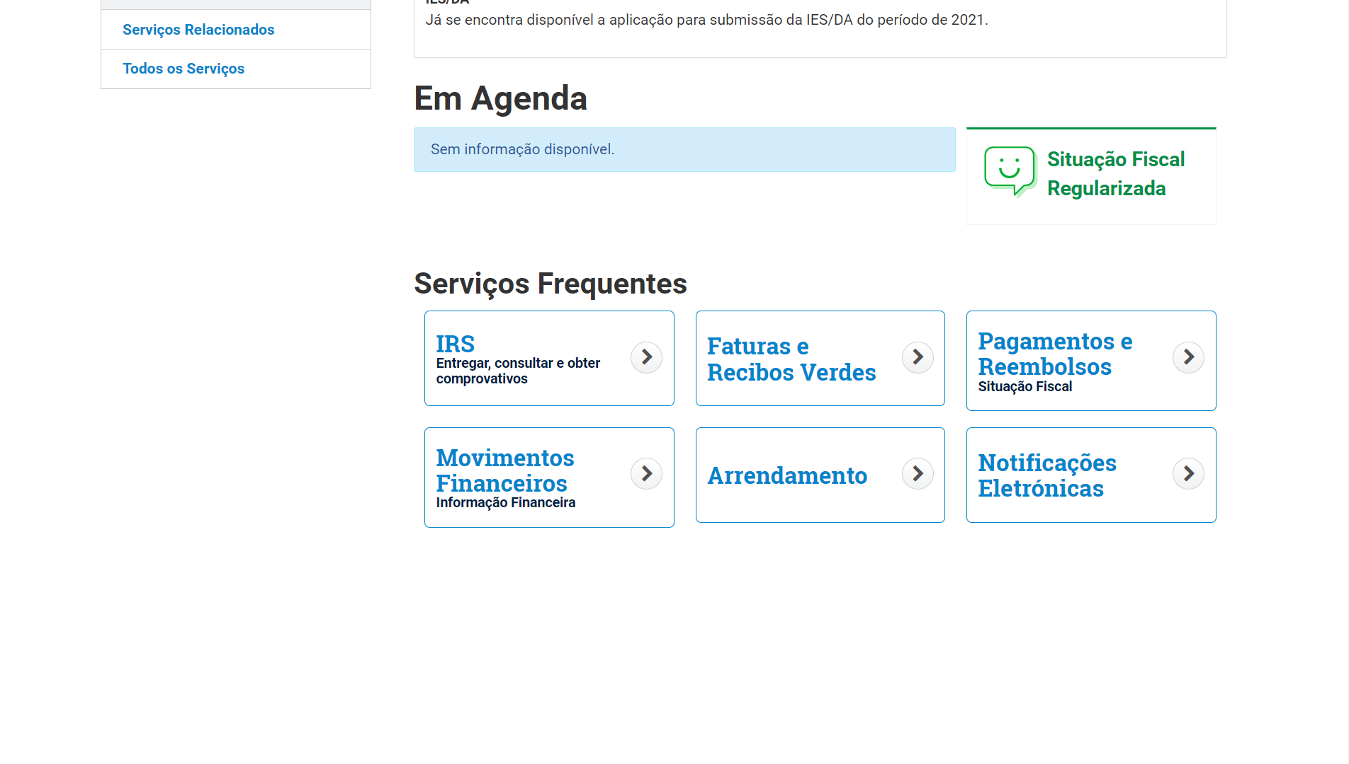
FAQ Page
Frequent services
The FAQ page is accessible from every page in the page’s footer
The frequent services can be easily accessed through a shortcut in the first page

Slide 19
06.
Appreciation

Slide 20
Appreciation
Usability
Utility
Improvements
In terms of usability, we believe the website has low quality. There is lack of effectiveness, efficiency and satisfaction during the user experience.
Based in our evaluation, the website has issues that can be easily fixed to boost the quality of the user experience.
The website is very useful and a crucial tool to the citizens, with multiple features that can help them in their financial tasks.

